Slide 1
ECE 372A Proposal Submission Requirements
Must state the problem you are trying to solve.
Must propose your solution to the problem.
Must define 4 requirements of the solution that you will use to determine the level of success.
Requirements must have measurable outcomes.
You will determine your criteria to grade your performance (rubric) for each requirement.
Project must include one input sensor minimum.
Must use sensor measurements to control an output device.
Must have one part of your system (input or output devices) utilize Serial Communication protocol (I2C, RS232 or SPI).
A template for initial proposal is given on the following slides

Slide 2
Project Title Group # x
ECE 372A – Microcontroller organization
Electrical and computer engineering
University of Arizona

Slide 3
Team Members
List team members and each of their roles.

Slide 4
Statement of Problem
Describe the problem you are trying to solve

Slide 5
Proposed Prototype Solution
Briefly describe your proposed prototype solution

Slide 6
Requirements
Requirement 1 – State each requirement and how you will measure the outcome
Requirement 2
Requirement 3
Requirement 4
…..

Slide 7
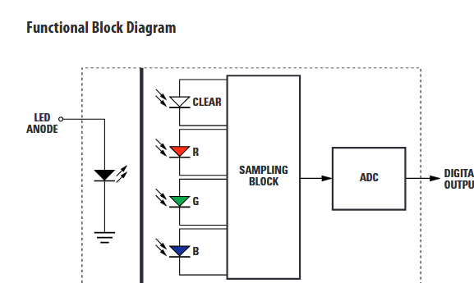
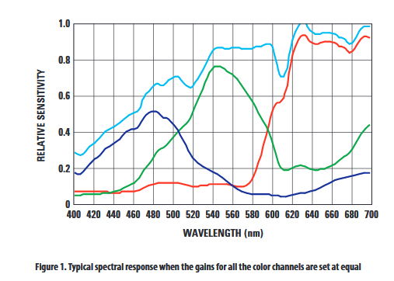
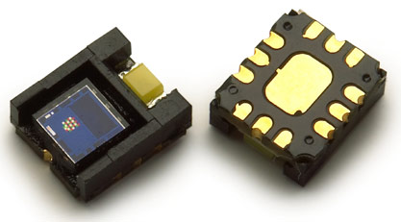
Input Sensor type(s)
One slide for each sensor with relevant performance specifications
Link on Web to datasheet.
Example -
Avago ADJD-S371-QR999
RGB Digital Color Sensor Module

Slide 8
Output Devices
List the type of Output device(s) you will use.
How input sensor will be used to control the output device.

Slide 9
Communication Protocol
Description of Protocol Used (I2C, SPI or RS232) for either an input device or output device.

